Slide 1
Navigating the Office: Real-World Workplace Wisdom
Bharath ASHOk

Slide 2
Team Roles and Responsibilities

Slide 3
Common Team Roles
Team Leader/Manager:
Provides direction, sets goals, and ensures the team's success.
Makes decisions, allocates tasks, and manages team dynamics.
Project Manager:
Oversees project-specific tasks, timelines, and resources.
Coordinates with stakeholders and ensures the project stays on track.
Technical Specialist/Architect:
Brings technical expertise to solve specific problems or challenges.
May act as a subject matter expert in a particular domain.
IT Coordinator:
Organizes meetings, ensures smooth communication, and removes obstacles.
Coordinates tasks and resources among team members.
Contributor/Team Member:
Completes assigned tasks and collaborates with others.
Plays a vital role in executing the team's goals.

Slide 4
Common Team Roles (SCRUM)
Scrum Master (Agile/Scrum Teams):
Serves as a servant-leader to the Scrum team.
Facilitates Scrum ceremonies (Sprint planning, daily stand-ups, etc.).
Removes impediments and ensures the Scrum process is followed.
Product Owner (Agile/Scrum Teams):
Represents the customer's needs and priorities.
Manages the product backlog and sets the direction for the product.
Collaborates with the team to ensure the product meets customer requirements.

Slide 5
Agile Methodology and Scrum Meetings

Slide 6
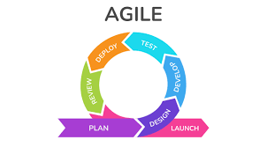
Agile Methodology Overview
Agile is a project management and product development approach.
Agile prioritizes flexibility, collaboration, and customer satisfaction.
It is based on the Agile Manifesto, which values individuals and interactions, working solutions, and customer collaboration.

Slide 7
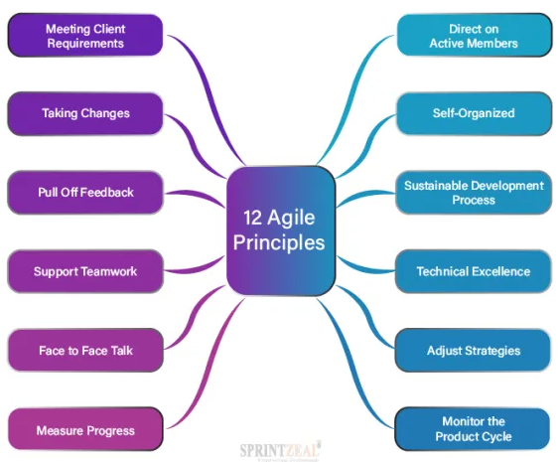
The Agile Manifesto
Individuals and interactions over processes and tools
Working solutions over comprehensive documentation
Customer collaboration over contract negotiation
Responding to change over following a plan

Slide 8
Scrum Framework
Scrum is a specific Agile framework that provides a structured process for managing complex projects.
It is based on iterations, called Sprints, which are typically 2-4 weeks long.

Slide 9
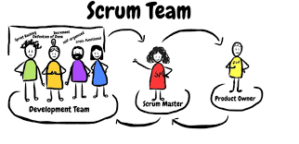
Scrum Roles
Product Owner: Represents the customer and prioritizes the product backlog.
Scrum Master: Facilitates the Scrum process and helps the team.
Development Team: A self-organizing, cross-functional group responsible for delivering the product.

Slide 10
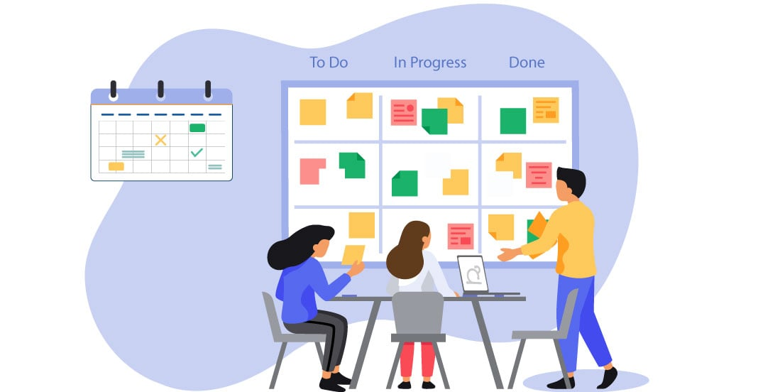
Scrum Meetings – Stand Up Call
A short, daily meeting where team members discuss progress, plans, and any obstacles.
Each team member answers three questions:
What have I done?
What will I do?
Are there any impediments?

Slide 11
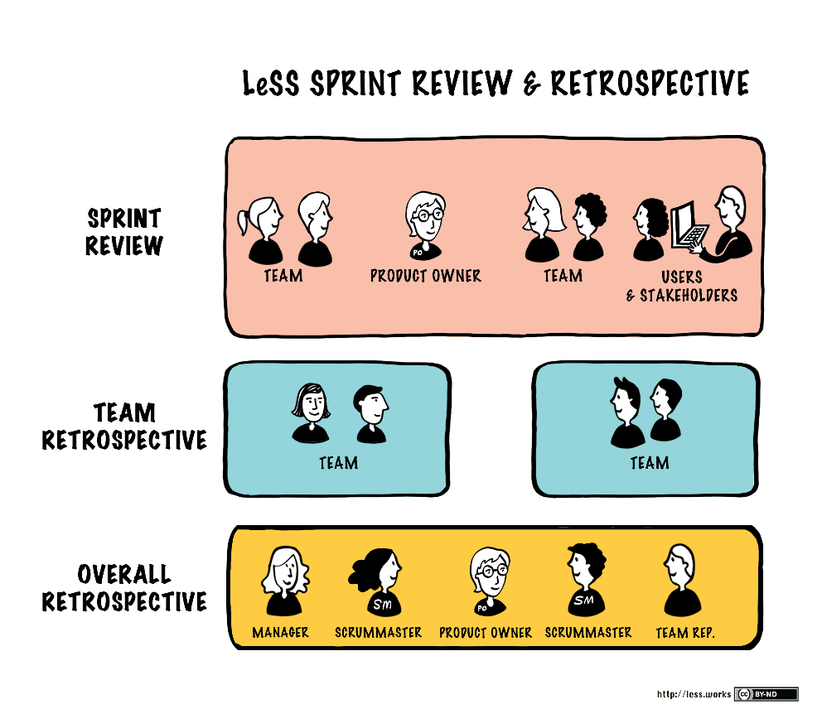
Scrum Meetings - Sprint Review
At the end of each Sprint, the team presents the work completed to stakeholders and receives feedback.
The product backlog may be adjusted based on feedback.

Slide 12
Scrum Meetings - Sprint Retrospective
A meeting at the end of each Sprint where the team reflects on their process and identifies ways to improve.
Continuous improvement is a key aspect of Scrum.

Slide 13
Benefits of Agile and Scrum
Flexibility to adapt to changing requirements.
Increased collaboration among team members.
Faster delivery of working product increments.
Improved customer satisfaction.

Slide 14
Version Control Systems and Deployment Styles

Slide 15
Introduction to Version Control Systems (VCS)
A system that tracks changes to files and directories over time.
Facilitates collaboration and enables tracking of code history.

Slide 16
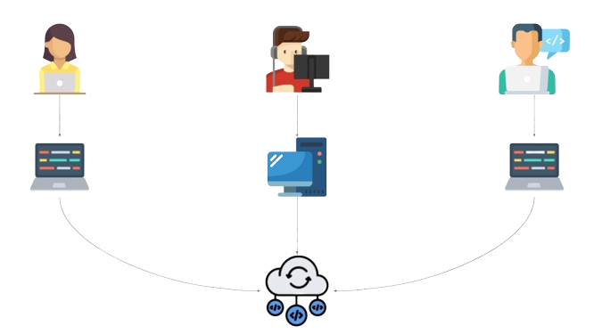
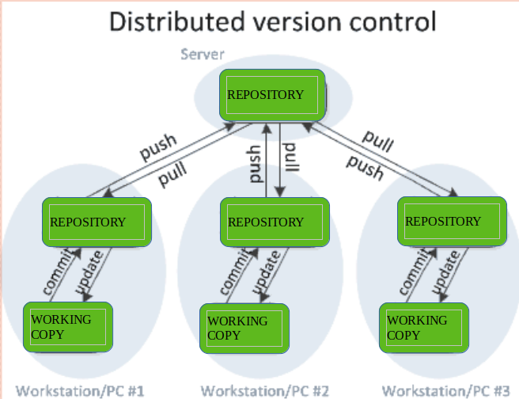
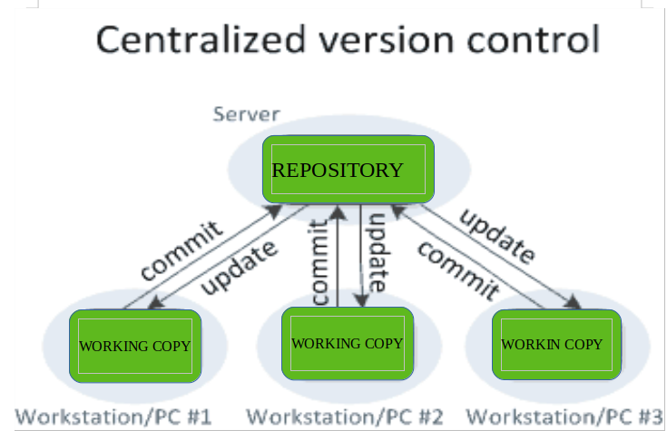
Types of VCS
Centralized VCS: A single central repository where developers commit their changes.
Distributed VCS: Each developer has a local copy, and changes can be synchronized with other copies.

Slide 17
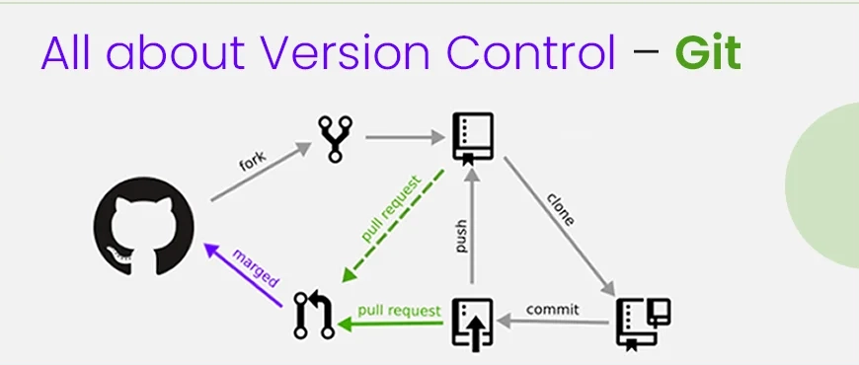
Introduction to Git Version Control System
Git Version control tracks changes to files over time.
It enables multiple people to work on the same project.
Git is a distributed version control system.
It's open-source and widely used in software development.

Slide 18
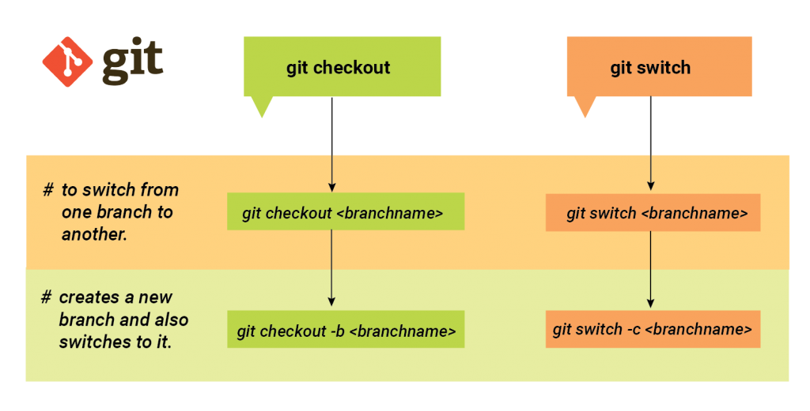
Key Git Terminology
Repository (Repo): The database that stores your project's version history.
Commit: A snapshot of the project at a specific point in time.
Branch: A parallel version of the repository.
Merge: Combining changes from one branch into another.
Clone: Copying a repository to your local machine.

Slide 19
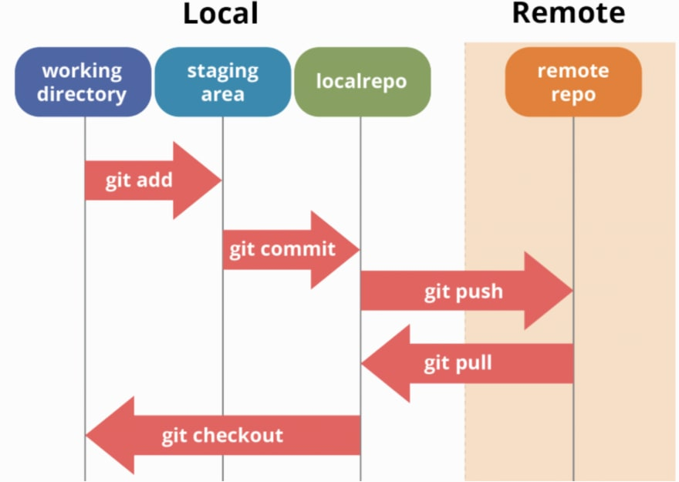
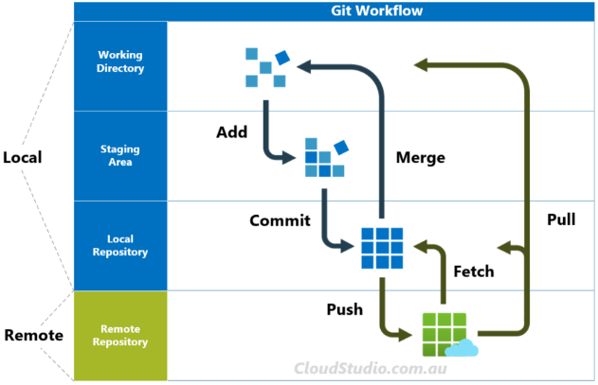
Git Workflow
Working Directory: Where you make changes to files.
Staging Area: Where you prepare files for commit.
Local Repository: Where committed changes are saved.
Remote Repository: A shared, online repository (e.g., GitHub).

Slide 20
Common Git Commands
git init: Initialize a new Git repository.
git add: Add changes to the staging area.
git commit: Create a snapshot of changes.
git push: Send changes to the remote repository.
git pull: Retrieve changes from the remote repository.
git clone: Create a local copy of a remote repository.

Slide 21
Collaborative Development with Git
Multiple developers can work on the same project.
Branches allow developers to work on features independently.
Merging and pull requests integrate changes.

Slide 22
Benefits of Using VCS
Version tracking for code changes.
Collaboration among team members.
Rollback to previous versions.
Branching and merging for feature development.

Slide 23
Deployment Styles

Slide 24
Introduction to Deployment Styles
The process of making software available for use, either internally or externally.
Different deployment styles cater to various project requirements.

Slide 25
Deployment Styles in Software Development
Continuous Integration (CI) and Continuous Deployment (CD).
Staging and Production environments.
Blue-Green Deployment and Canary Releases.

Slide 26
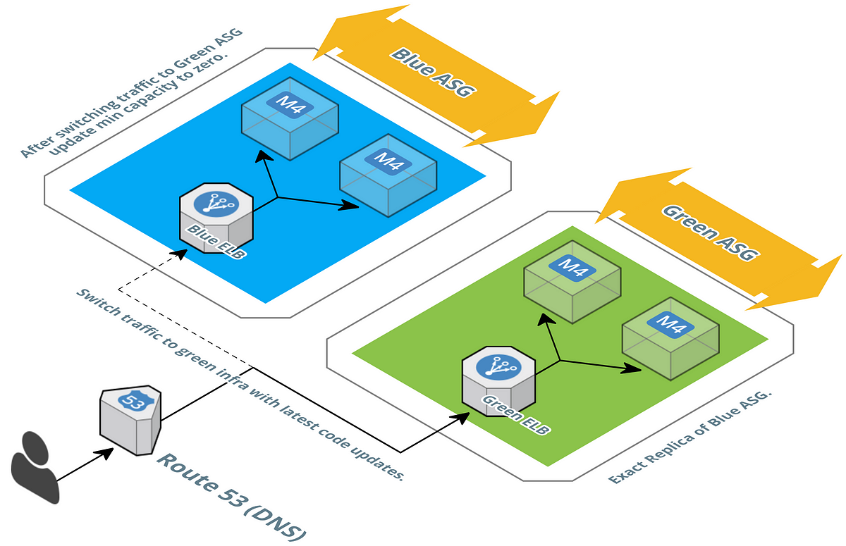
Blue-Green Deployment

Slide 27
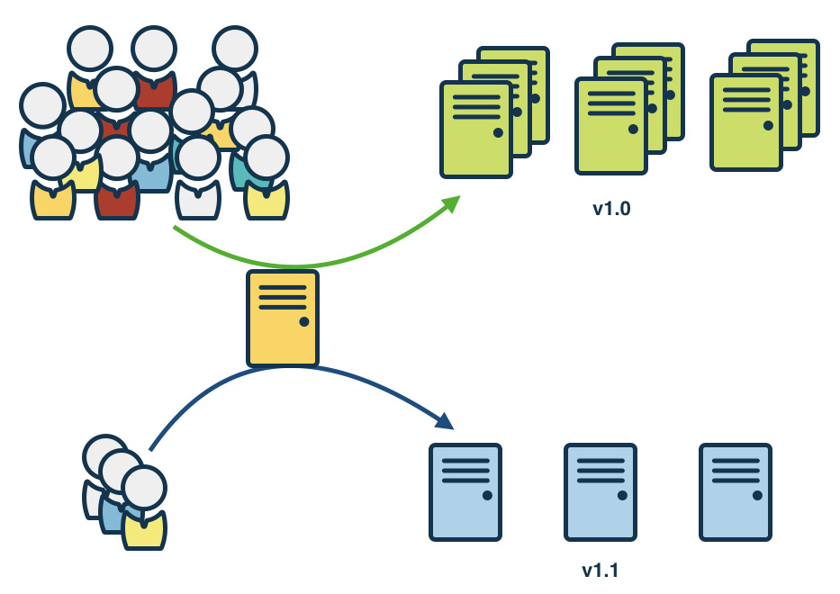
Canary Releases Deployment

Slide 28
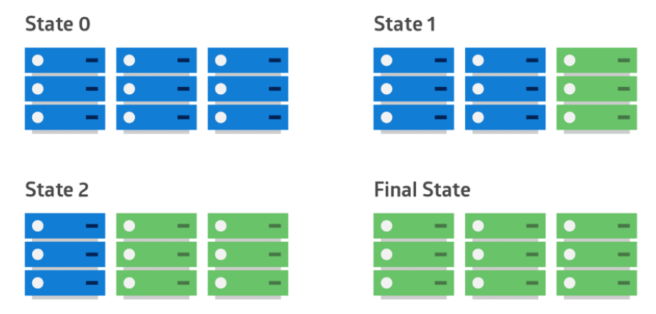
Rolling release Deployment

Slide 29
Choosing the Right Deployment Style
Project complexity and size.
Risk tolerance.
Speed of development and delivery.
End-user impact.

Slide 30
Best Practices
Consistent commit messages in VCS.
Automated testing in the CI/CD pipeline.
Backups and rollback strategies.
Documentation and communication.

Slide 31
Code Review and Pull Requests

Slide 32

Introduction to Code Review
Code review is the systematic examination of source code.
Developers review code to identify and fix issues before it is merged into the main codebase.

Slide 33
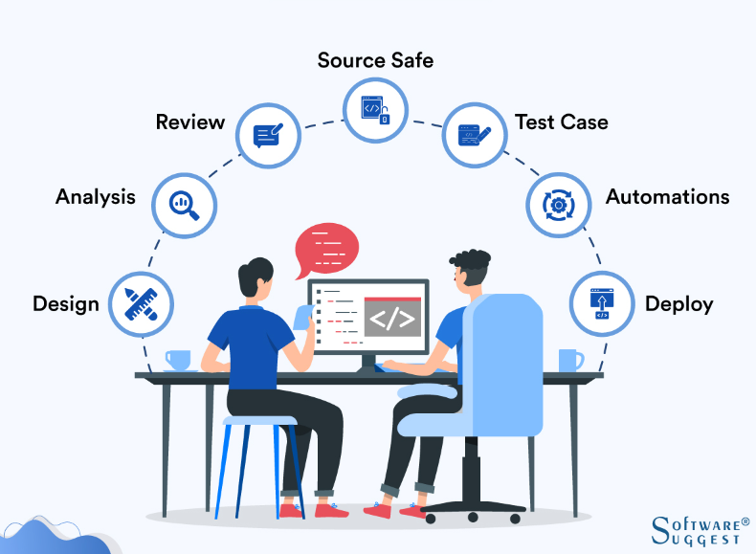
The Importance of Code Review
Reduces bugs and improves code quality.
Facilitates knowledge sharing among team members.
Enhances collaboration and accountability.

Slide 34
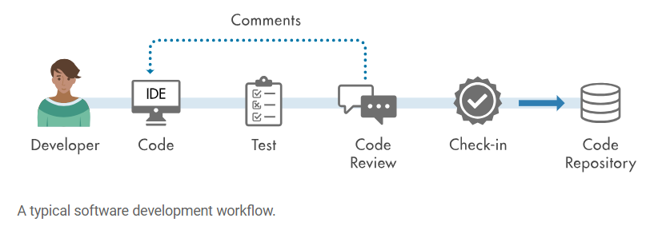
Code Review Process
A developer submits their code for review.
Reviewers examine the code and provide feedback.
The code author makes necessary changes.
The code is re-reviewed until it meets the standards.

Slide 35
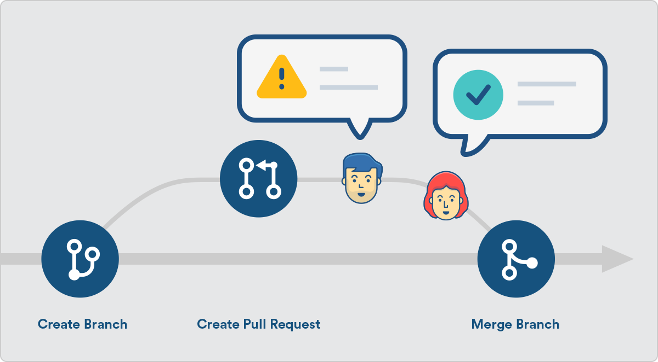
Introduction to Pull Requests
A mechanism to propose and discuss code changes.
Commonly used in version control systems like Git.

Slide 36
Benefits of Pull Requests
Encourages collaboration and discussion.
Offers transparency in the code change process.
Allows for automated testing and integration.

Slide 37
Pull Request Workflow
A developer creates a branch for their feature or bug fix.
They submit a pull request for review.
Reviewers provide feedback and approval.
After approval, the code is merged into the main branch.

Slide 38
PR Hands-On

Slide 39
Best Practices
Clearly defined coding standards and guidelines.
Use of automated testing and continuous integration.
Constructive feedback and a positive, collaborative tone.

Slide 40
Thank You.

